Slide 1
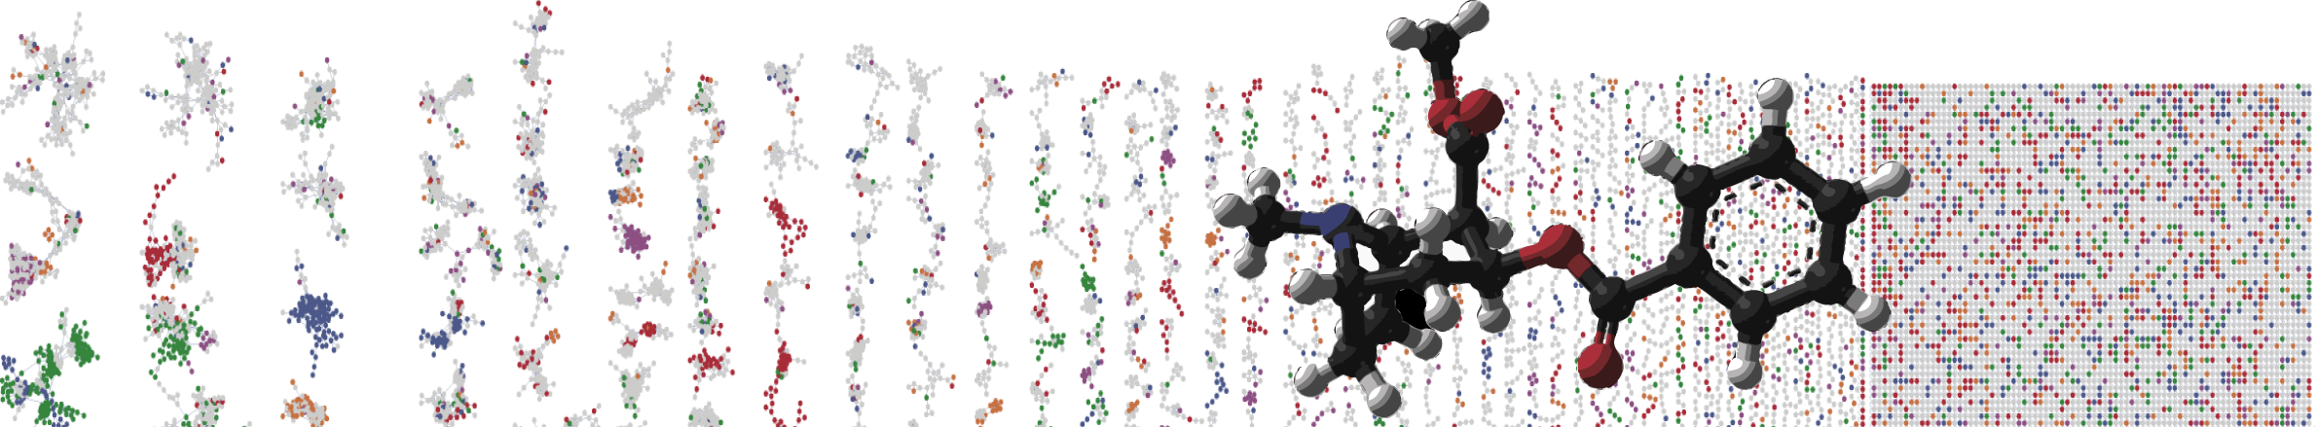


DEREPLICATOR
In silico Peptidic Natural Products Tools
PRESENTER’S NAME
University of California - San Diego

Slide 2
Objectives and Data
Utilize GNPS online interface for Dereplicator
Explore in silico candidates
Explore molecular network
Discover potentially new antibiotic analogs
EXAMPLE 1
GNPS Streptomyces Demo Data
MSV000082622

Slide 3
Objectives and Data
Utilize GNPS online interface for Dereplicator
Explore in silico candidates
Explore molecular network
Discover potentially new antibiotic analogs
EXAMPLE 2
GNPS - Staphylococcus healthy skin isolates
MSV000083956

Slide 4
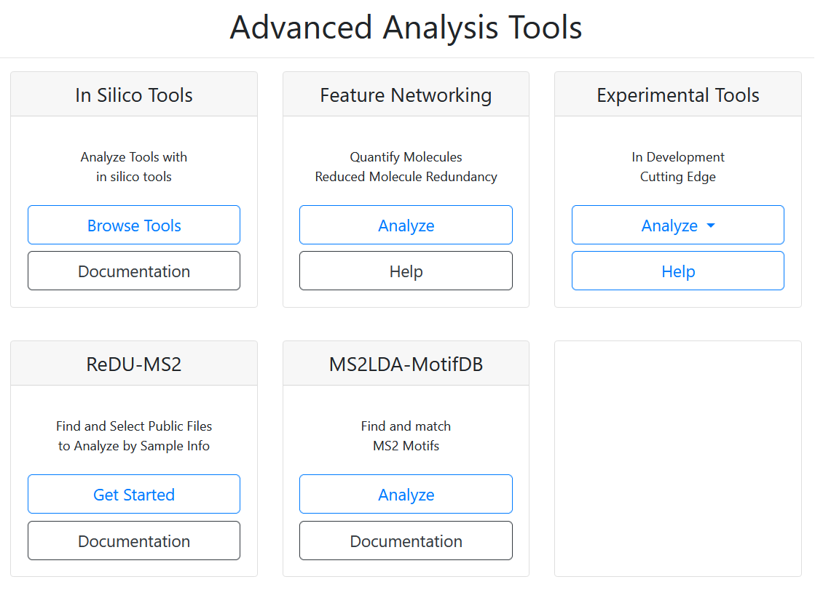

Slide 5
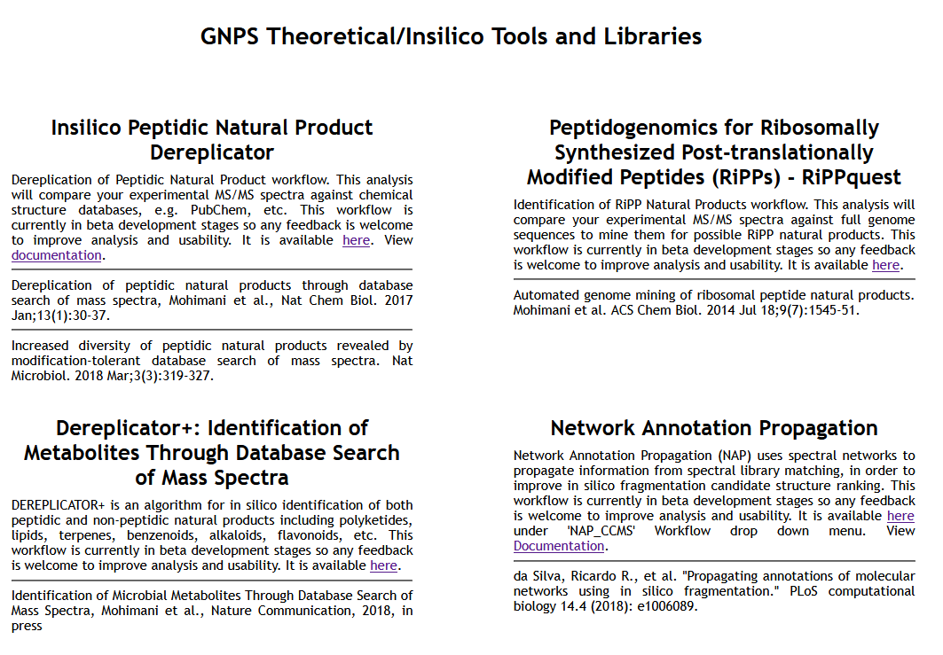
Mohimani, H. et al. Nat Chem Biol 2017, 13, 1, 30-37

Slide 6
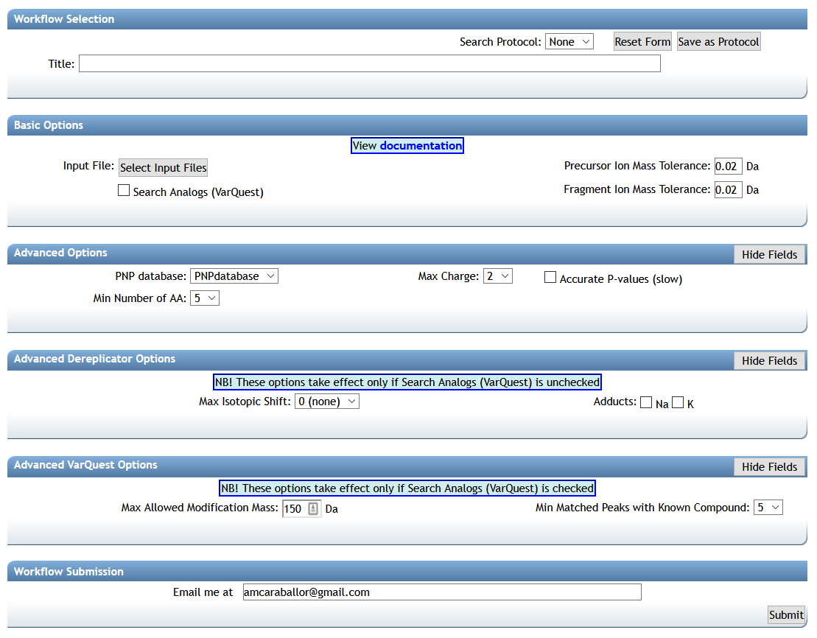

Slide 8
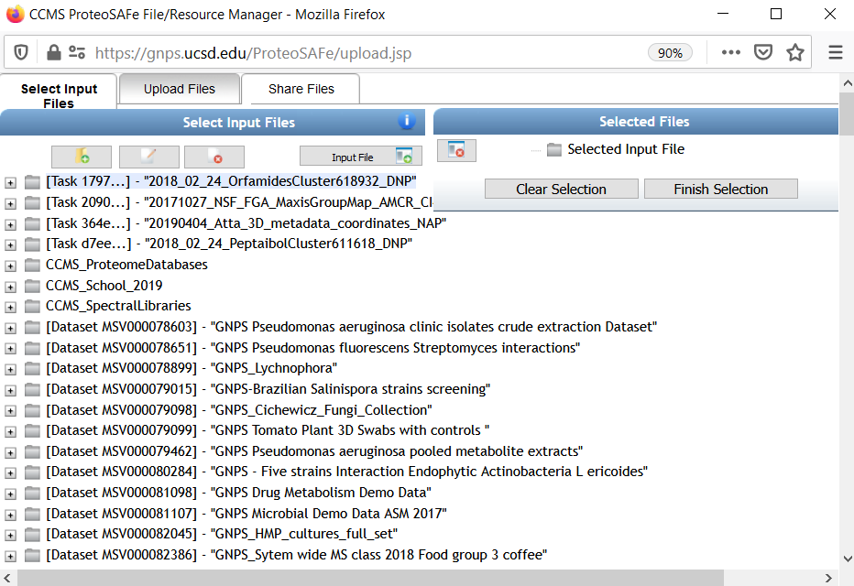

Slide 9
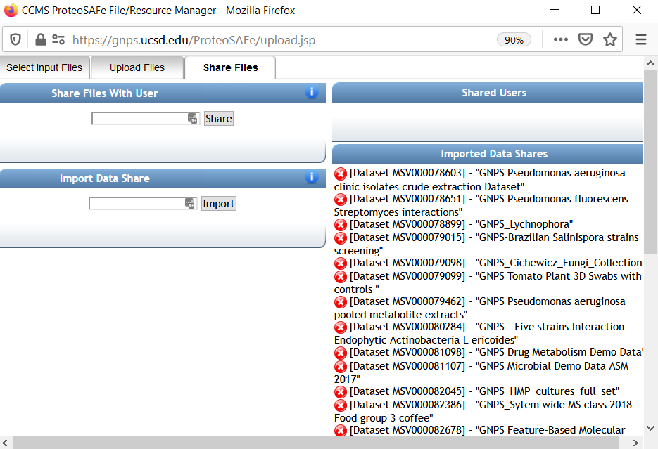
MSV000082622
EXAMPLE 1

Slide 10
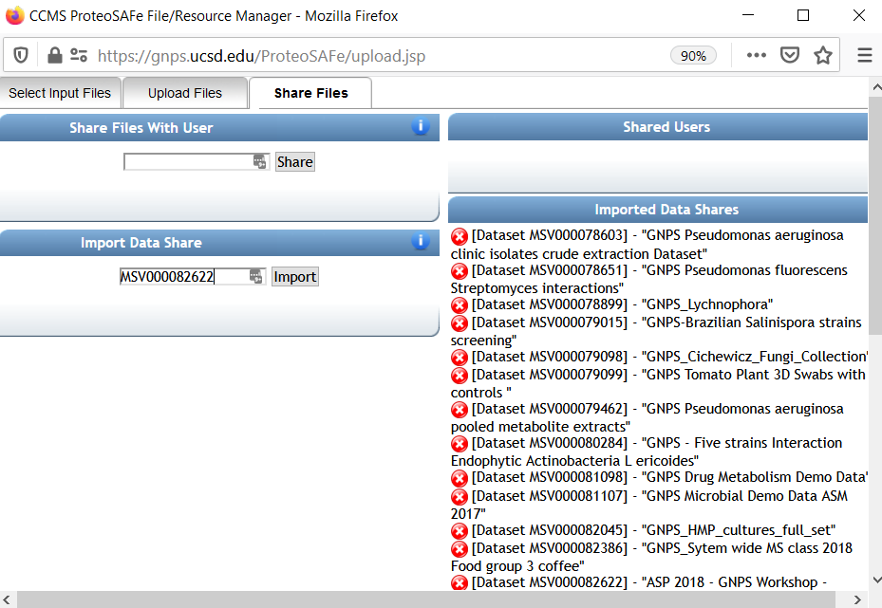

Slide 11
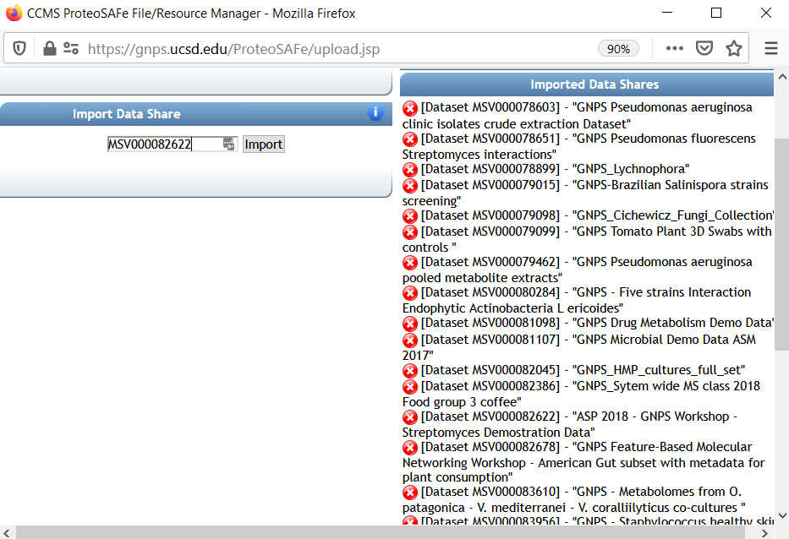

Slide 13
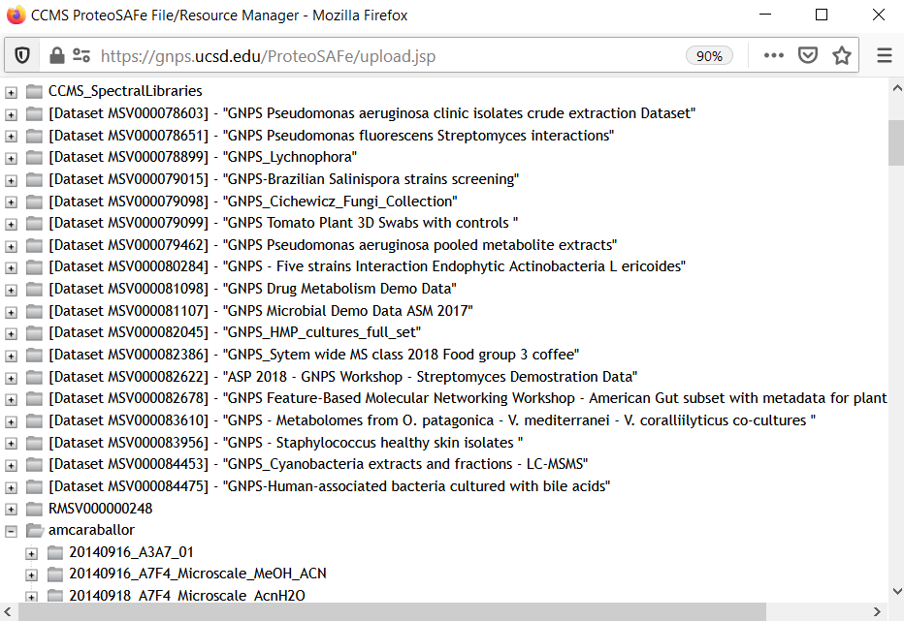

Slide 14
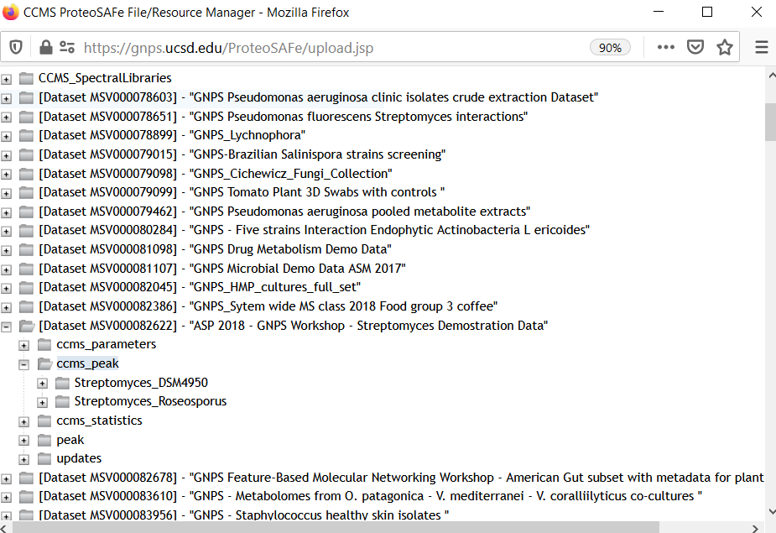

Slide 15
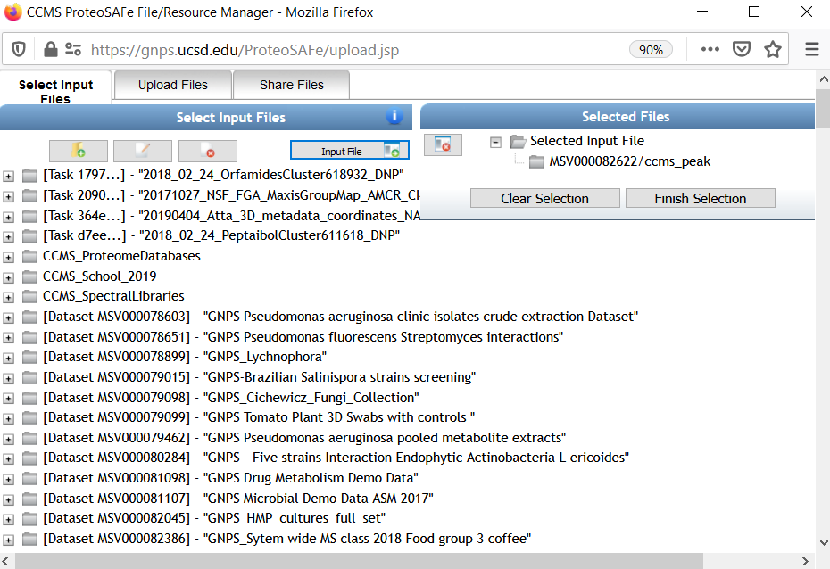

Slide 19
Precursor Ion Mass Tolerance: This value specifies how much fragment ions can be shifted from their expected m/z values. Default value is ± 0.02 Da for high-resolution instruments (q-TOF, q-Orbitrap) and ± 0.5 Da for low-resolution instruments (ion traps, QqQ).

Slide 20
Fragment ion Mass Tolerance: This value specifies how much fragment ions can be shifted from their expected m/z values. Default value is ± 0.02 Da for high-resolution instruments (q-TOF, q-Orbitrap) and ± 0.5 Da for low-resolution instruments (ion traps, QqQ).

Slide 21
Search analog (VarQuest) [RECOMMENDED TO USE]: The VarQuest algorithm can search for analogs of known natural products in MS/MS data using Dereplicator. VarQuest is a modification-tolerant database search tool that discovers unexpected modifications in a blind mode. Since the computational space for variable PNP identification is computationally expensive, VarQuest first constructs a set of feasible PSM using a simple scoring approach and further filters out this set using a rigorous scoring method. Using VarQuest will increase the job time. The use of VarQuest analogs option is recommended as it expands the search space, and it reduces the overall run time.
Gurevich, A. et al. Nat Microbiol 3, 319–327 (2018) doi:10.1038/s41564-017-0094-2

Slide 22
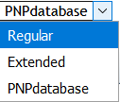
PNP database : a choice of two databases Regular/Extended (Extended one is more informative but 2 times larger, i.e. two times slower processing)

Slide 23
Mimimum number of AA: Dereplicator is able to search for short peptides. This parameter determines what is the minimum number of amino acids, we consider for the compounds that are considered in Dereplicator search.

Slide 24
Accurate P-values : accurate (but slow) algorithm for P-value computation (MS-DPR), by default raw estimation is used.

Slide 25
Max charge: Maximum charge allowed.

Slide 26
Max Isotopic Shift: When working with molecules with 1000 Da or higher masses, mass spectrometers commonly predict the precursor mass 1 or 2 Da higher than the monoisotopic mass due to the isotopic pattern. Setting Maximum isotopic shift to higher than 0 allows Dereplicator to consider these shifts in the precursor mass.

Slide 27
Adducts : Dereplicator can search in addition to protonated adducts, sodiated and potassium adducts

Slide 28
Max Allowed Modification Mass : Maximum difference allowed between the precursor ion of an unknown modified peptide and the (dereplicated) known peptide.

Slide 29
Min Matched Peaks with Known Compound : Minimum number of common peaks between the MS/MS spectrum of an unknown modified peptide and the (dereplicated) known peptide.

Slide 30
EXAMPLE 1
GNPS Streptomyces Demo Data
MSV000082622

Slide 31
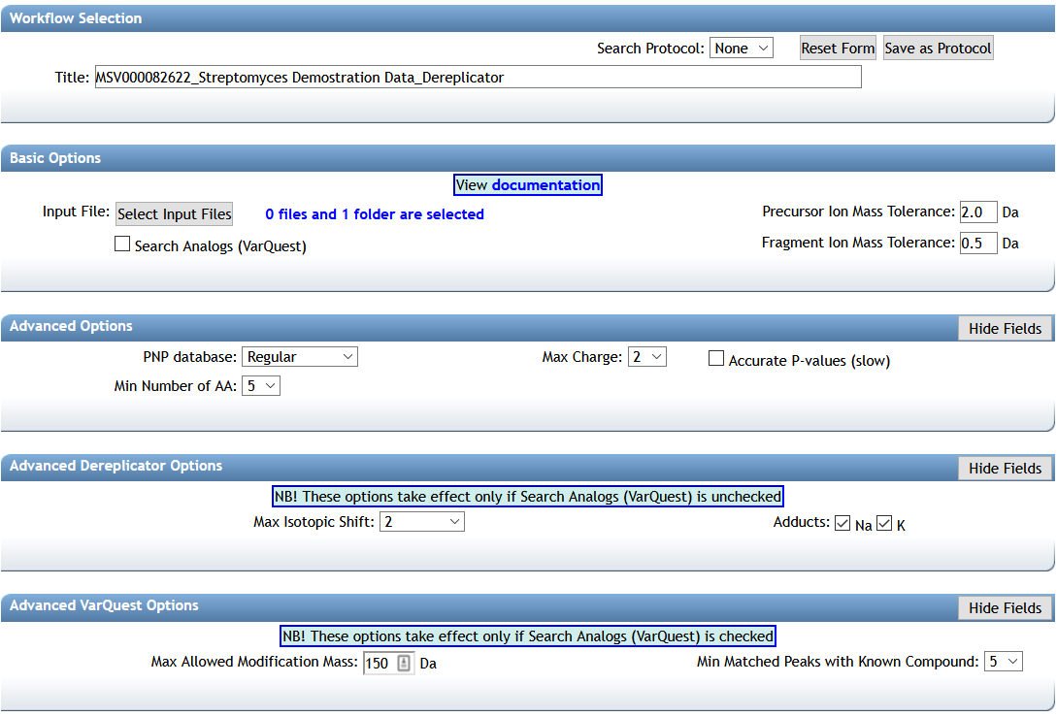
EXAMPLE 1 Dereplicator
GNPS Streptomyces Demo Data
MSV000082622

Slide 32
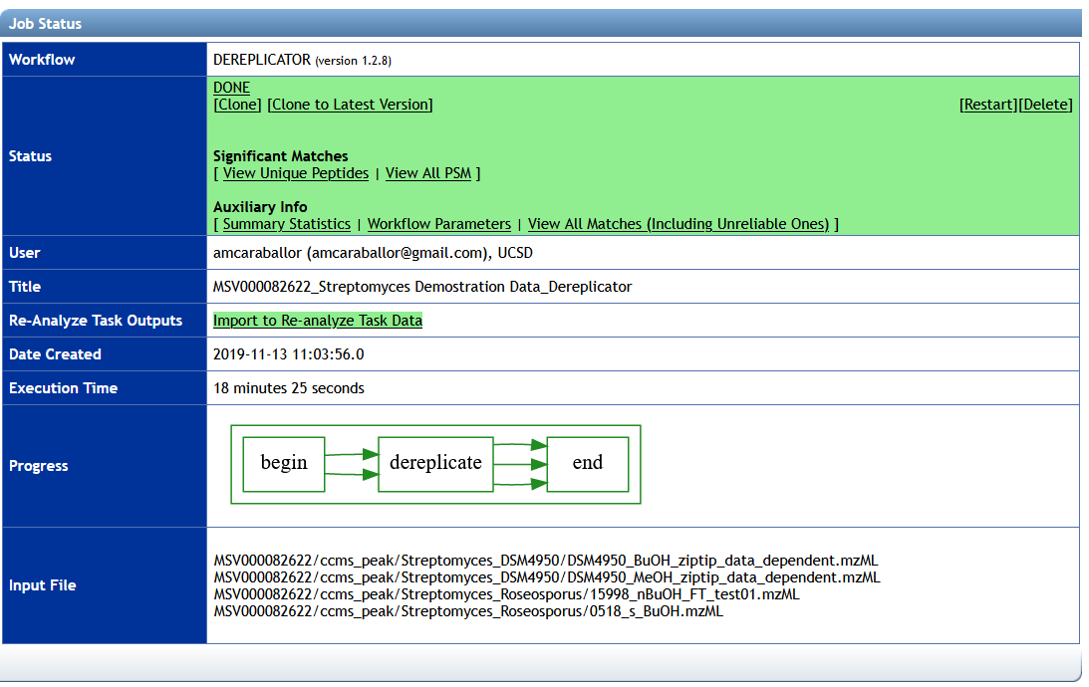
EXAMPLE 1 Dereplicator
GNPS Streptomyces Demo Data
GNPS Job link: https://gnps.ucsd.edu/ProteoSAFe/status.jsp?task=bc07013e25584d6f8f022d53eeb2384d

Slide 33
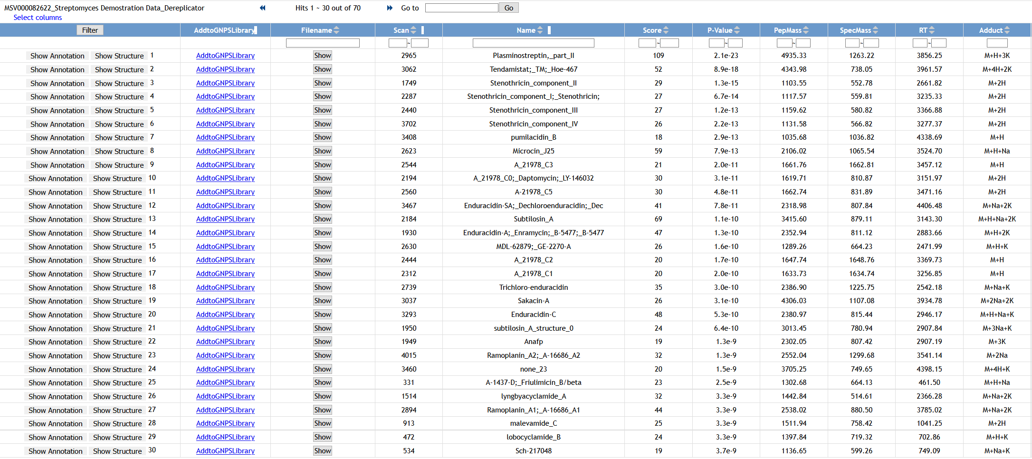
EXAMPLE 1 Dereplicator
GNPS Streptomyces Demo Data
GNPS Job link: https://gnps.ucsd.edu/ProteoSAFe/status.jsp?task=bc07013e25584d6f8f022d53eeb2384d

Slide 34
EXAMPLE 1 Dereplicator
GNPS Streptomyces Demo Data
GNPS Job link: https://gnps.ucsd.edu/ProteoSAFe/status.jsp?task=bc07013e25584d6f8f022d53eeb2384d

Slide 35
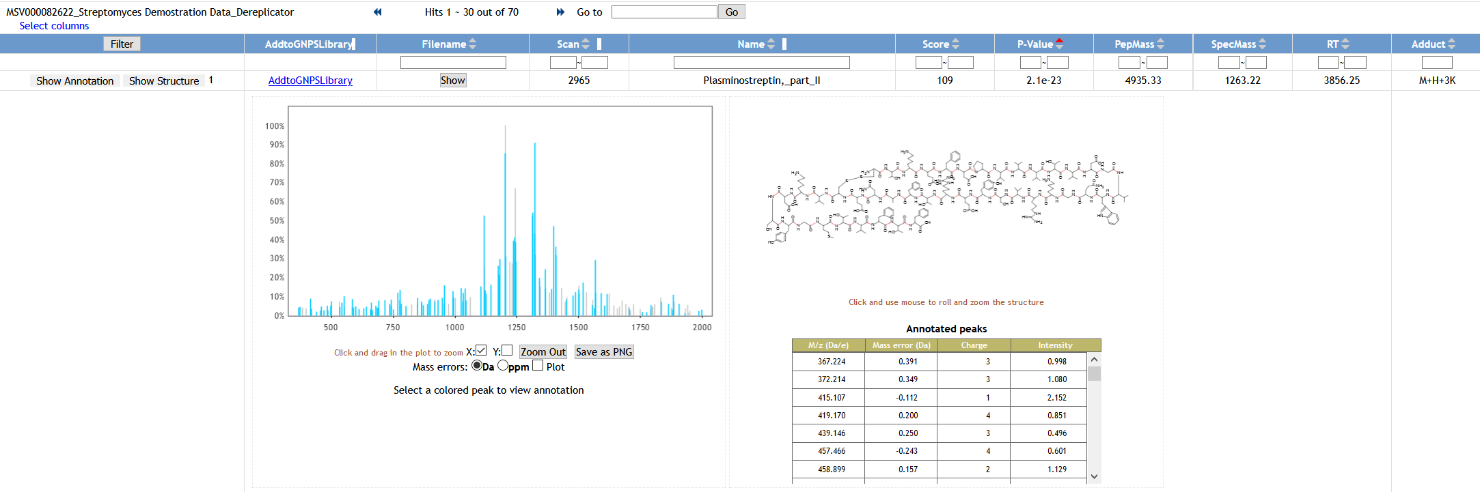
EXAMPLE 1 Dereplicator
GNPS Streptomyces Demo Data
GNPS Job link: https://gnps.ucsd.edu/ProteoSAFe/status.jsp?task=bc07013e25584d6f8f022d53eeb2384d
The blue peaks are fragment ions that matched the fragmentation tree of peptidic natural products in the database.

Slide 36
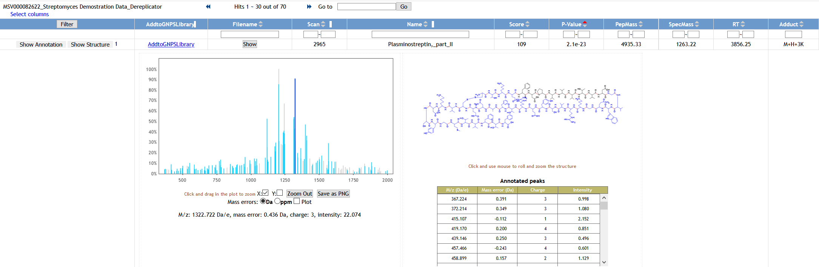
EXAMPLE 1 Dereplicator
GNPS Streptomyces Demo Data
GNPS Job link: https://gnps.ucsd.edu/ProteoSAFe/status.jsp?task=bc07013e25584d6f8f022d53eeb2384d
Click on a blue peak to highlight the corresponding fragment on the molecular structure

Slide 37
EXAMPLE 1 Dereplicator
GNPS Streptomyces Demo Data
GNPS Job link: https://gnps.ucsd.edu/ProteoSAFe/status.jsp?task=bc07013e25584d6f8f022d53eeb2384d
Plasminostreptin, a protein proteinase inhibitor produced by Streptomyces antifibrinolyticus.
J Biol Chem. 1978, 10, 253(5), 1529-37
Click on a blue peak to highlight the corresponding fragment on the molecular structure

Slide 38
Discussion
EXAMPLE 1 Dereplicator
What peptide candidates did you find using the Dereplicator workflow from the GNPS Streptomyces Demo Data
GNPS Job link: https://gnps.ucsd.edu/ProteoSAFe/status.jsp?task=bc07013e25584d6f8f022d53eeb2384d
Compare results with the classical molecular network for EXAMPLE 1
MSV000082622_GNPS Paper Stenothricin Network - V2 Networking
GNPS Job link: https://gnps.ucsd.edu/ProteoSAFe/status.jsp?task=2fd31c1651cc41cfbff9d1d473f03cc3

Slide 39
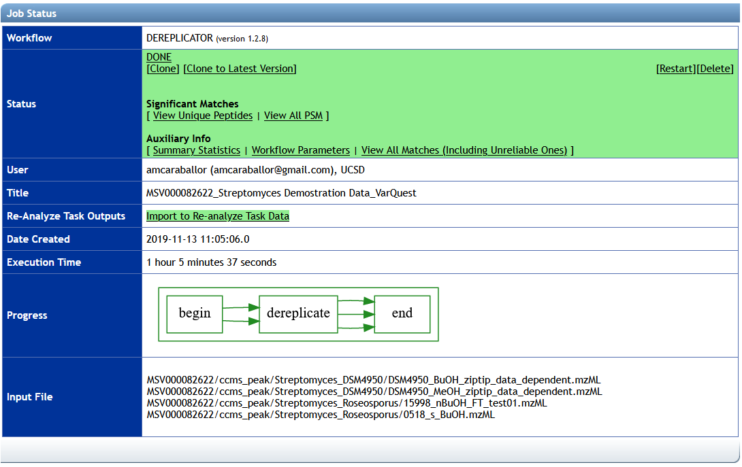
EXAMPLE 1 VarQuest
GNPS Streptomyces Demo Data
GNPS Job link: https://gnps.ucsd.edu/ProteoSAFe/status.jsp?task=7a58471f1273400fb5a5379ea1685f77

Slide 40
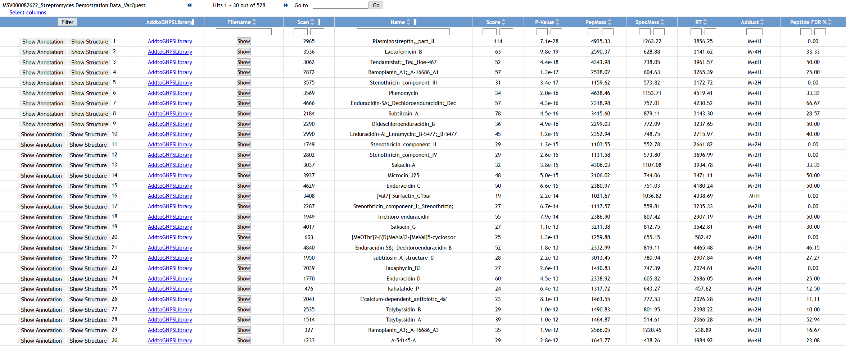
EXAMPLE 1 VarQuest
GNPS Streptomyces Demo Data
GNPS Job link: https://gnps.ucsd.edu/ProteoSAFe/status.jsp?task=7a58471f1273400fb5a5379ea1685f77

Slide 41
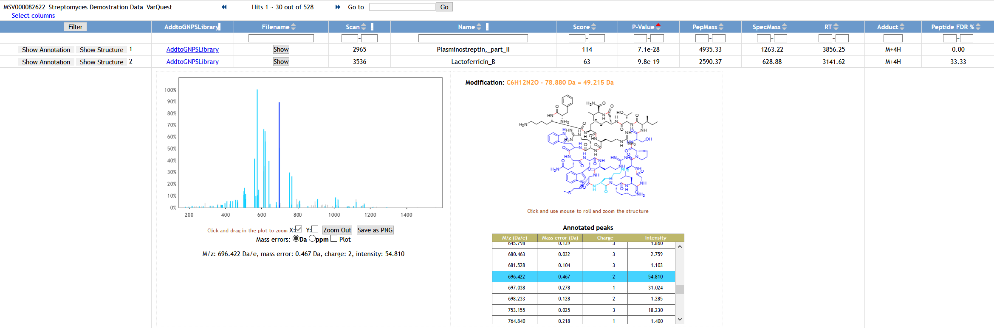
EXAMPLE 1 VarQuest
GNPS Streptomyces Demo Data
GNPS Job link: https://gnps.ucsd.edu/ProteoSAFe/status.jsp?task=7a58471f1273400fb5a5379ea1685f77
How reliable are the candidates?
Validate annotations: MS/MS quality, adducts, molecular formula, biological source…
Click on a blue peak to highlight the corresponding fragment on the molecular structure and visualize the probable location of the modification

Slide 42
Discussion
EXAMPLE 1 VarQuest
What peptide candidates did you find using the VarQuest workflow from the GNPS Streptomyces Demo Data
GNPS Job link: https://gnps.ucsd.edu/ProteoSAFe/status.jsp?task=7a58471f1273400fb5a5379ea1685f77
Compare results with the classical molecular network for EXAMPLE 1
MSV000082622_GNPS Paper Stenothricin Network - V2 Networking
GNPS Job link: https://gnps.ucsd.edu/ProteoSAFe/status.jsp?task=2fd31c1651cc41cfbff9d1d473f03cc3

Slide 43
EXAMPLE 2
GNPS - Staphylococcus healthy skin isolates
MSV000083956
Let’s use the results from the classical molecular network for EXAMPLE 2
MSV000083956_GNPS - Staphylococcus healthy skin isolates_V2Networking
GNPS Job link: https://gnps.ucsd.edu/ProteoSAFe/status.jsp?task=22c9205c1d58433384df3cfbbf79eb52
and run Dereplicator and VarQuest worflows

Slide 44
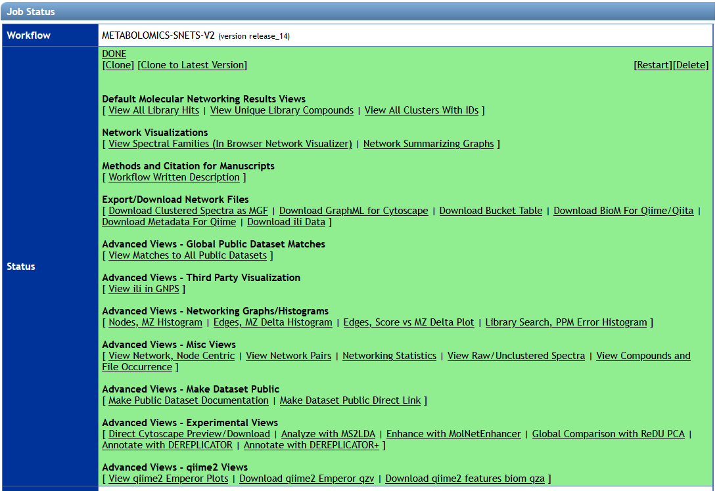
MSV000083956_GNPS - Staphylococcus healthy skin isolates_V2Networking
GNPS Job link: https://gnps.ucsd.edu/ProteoSAFe/status.jsp?task=22c9205c1d58433384df3cfbbf79eb52

Slide 45
MSV000083956_GNPS - Staphylococcus healthy skin isolates_V2Networking
GNPS Job link: https://gnps.ucsd.edu/ProteoSAFe/status.jsp?task=22c9205c1d58433384df3cfbbf79eb52

Slide 46
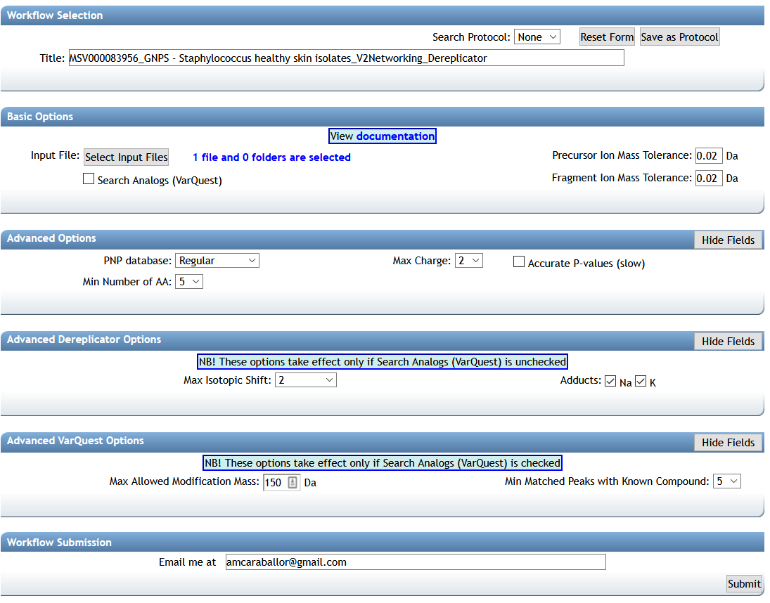
Dereplicator GNPS - Staphylococcus healthy skin isolates: https://gnps.ucsd.edu/ProteoSAFe/status.jsp?task=fdf83efe15a74e25ade33a2ef49b23f7
Your e-mail

Slide 47
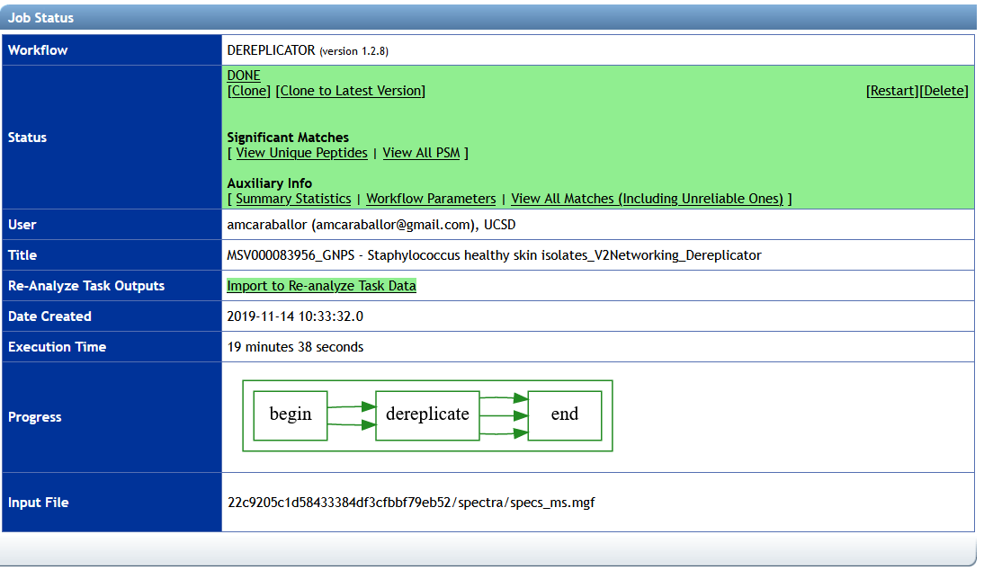
Dereplicator GNPS - Staphylococcus healthy skin isolates: https://gnps.ucsd.edu/ProteoSAFe/status.jsp?task=fdf83efe15a74e25ade33a2ef49b23f7

Slide 48
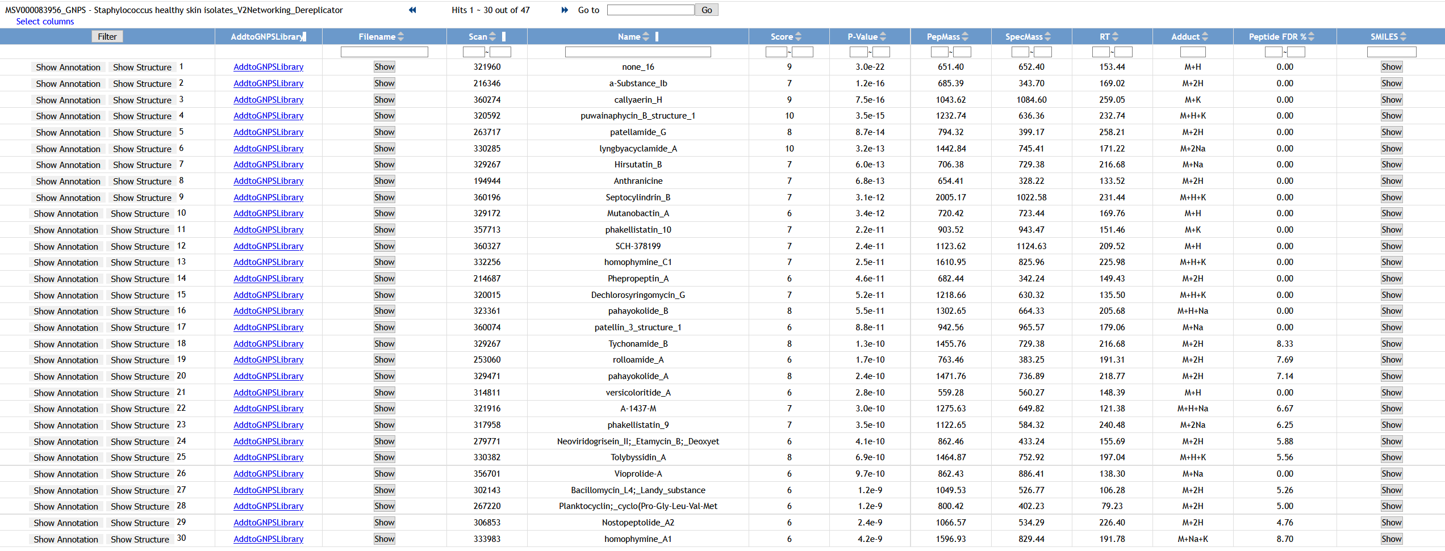
Dereplicator GNPS - Staphylococcus healthy skin isolates: https://gnps.ucsd.edu/ProteoSAFe/status.jsp?task=fdf83efe15a74e25ade33a2ef49b23f7

Slide 49
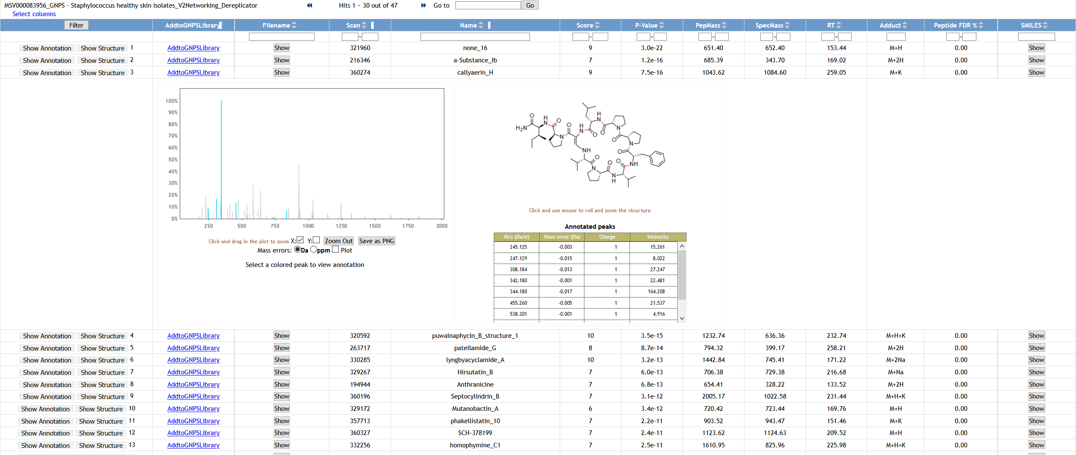
Dereplicator GNPS - Staphylococcus healthy skin isolates: https://gnps.ucsd.edu/ProteoSAFe/status.jsp?task=fdf83efe15a74e25ade33a2ef49b23f7

Slide 50
Dereplicator GNPS - Staphylococcus healthy skin isolates: https://gnps.ucsd.edu/ProteoSAFe/status.jsp?task=fdf83efe15a74e25ade33a2ef49b23f7
Validate the annotation.
Is it a reliable hit?

Slide 51
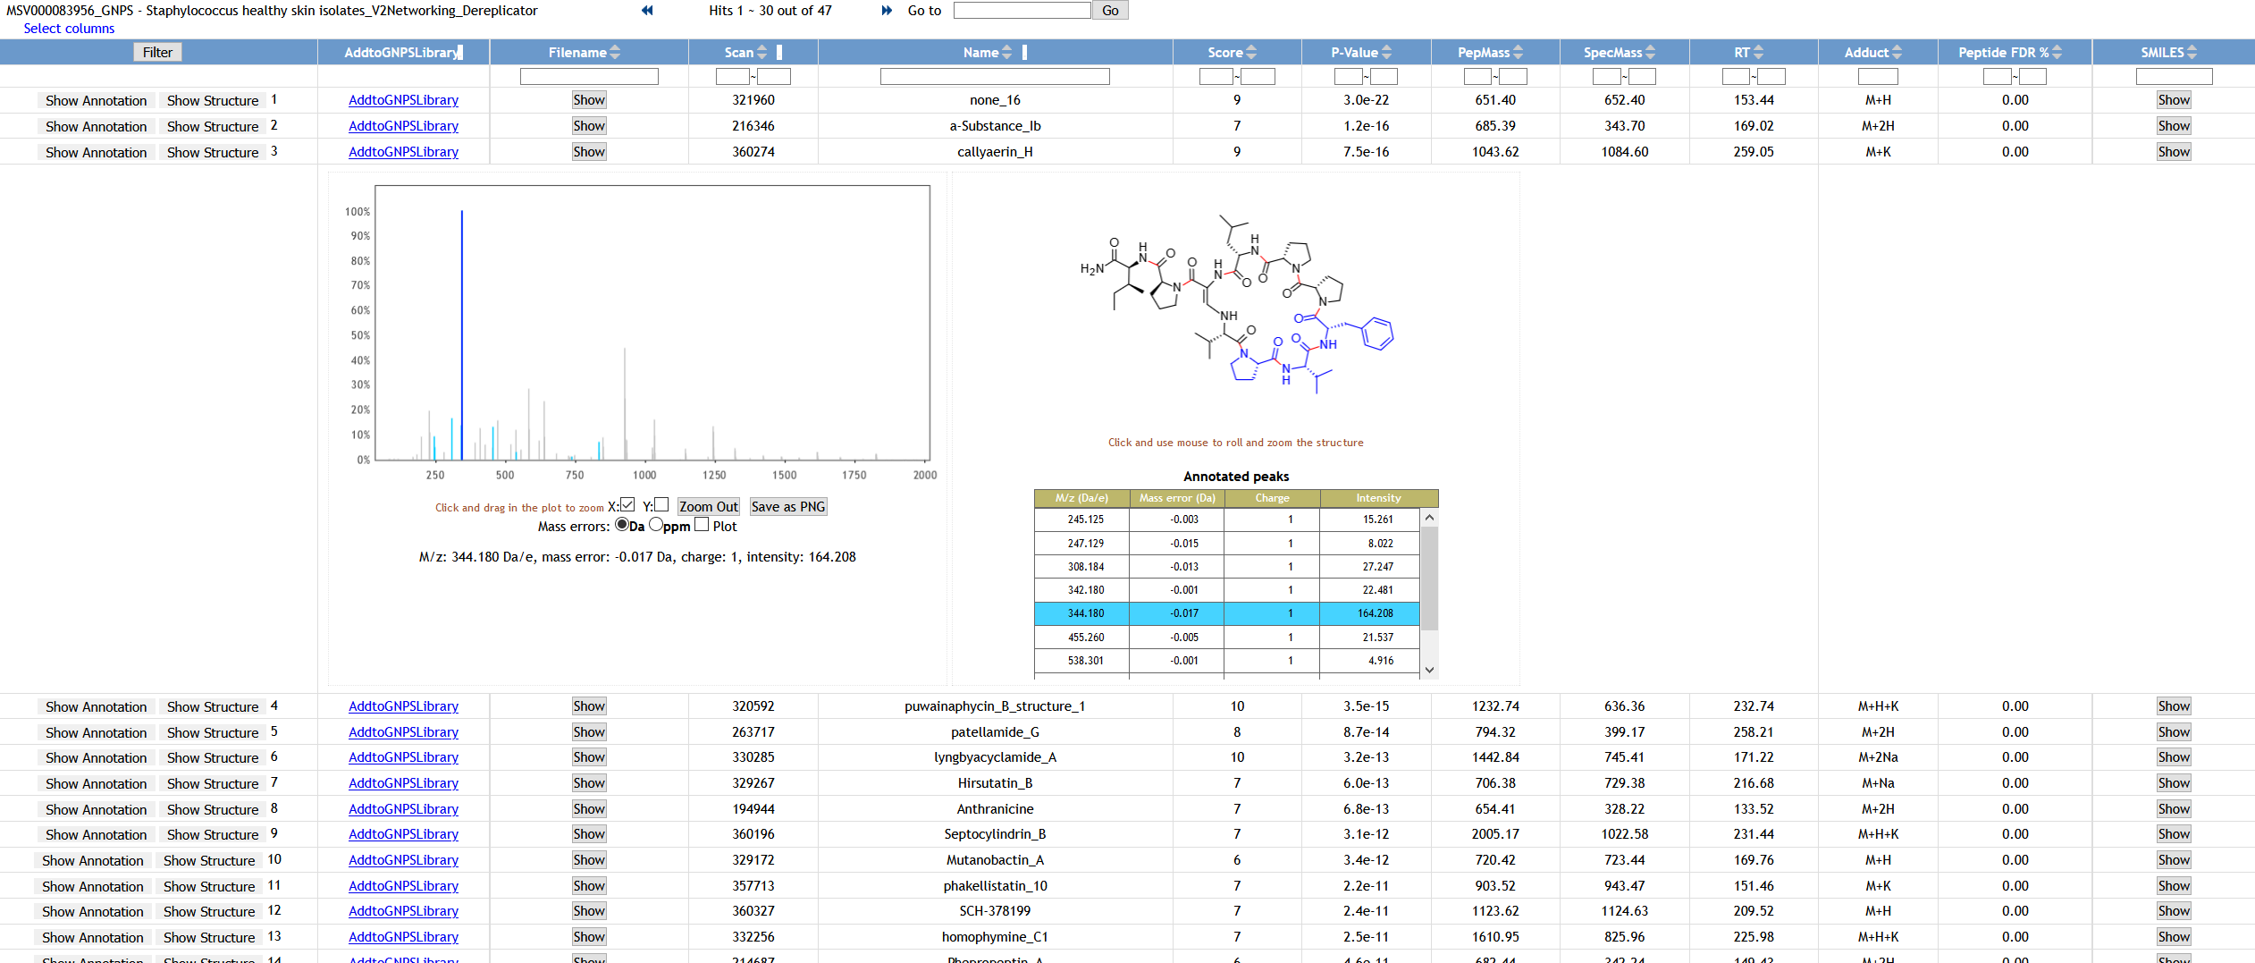
Dereplicator GNPS - Staphylococcus healthy skin isolates: https://gnps.ucsd.edu/ProteoSAFe/status.jsp?task=fdf83efe15a74e25ade33a2ef49b23f7
Callyaerins A–F and H, new cytotoxic cyclic peptides from the Indonesian marine sponge Callyspongia aerizusa
S. R. M. Ibrahim et al./Bioorg. Med. Chem. 18 (2010) 4947–4956

Slide 52
Discussion
What peptide candidates did you find using the Dereplicator workflow from the GNPS - Staphylococcus healthy skin isolates dataset?
MSV000083956
GNPS job link: https://gnps.ucsd.edu/ProteoSAFe/status.jsp?task=59e708a26434416e9c71e8eab9dc4bd0
Compare results with the classical molecular network for EXAMPLE 2
MSV000083956_GNPS - Staphylococcus healthy skin isolates_V2Networking
GNPS Job link: https://gnps.ucsd.edu/ProteoSAFe/status.jsp?task=22c9205c1d58433384df3cfbbf79eb52

Slide 53
MSV000083956_GNPS - Staphylococcus healthy skin isolates_V2Networking
GNPS Job link: https://gnps.ucsd.edu/ProteoSAFe/status.jsp?task=22c9205c1d58433384df3cfbbf79eb52

Slide 54

VarQuest GNPS - Staphylococcus healthy skin isolates: https://gnps.ucsd.edu/ProteoSAFe/status.jsp?task=f5496cbc5ab2400a813984069b7f8970
Your e-mail

Slide 55

VarQuest GNPS - Staphylococcus healthy skin isolates: https://gnps.ucsd.edu/ProteoSAFe/status.jsp?task=f5496cbc5ab2400a813984069b7f8970

Slide 56
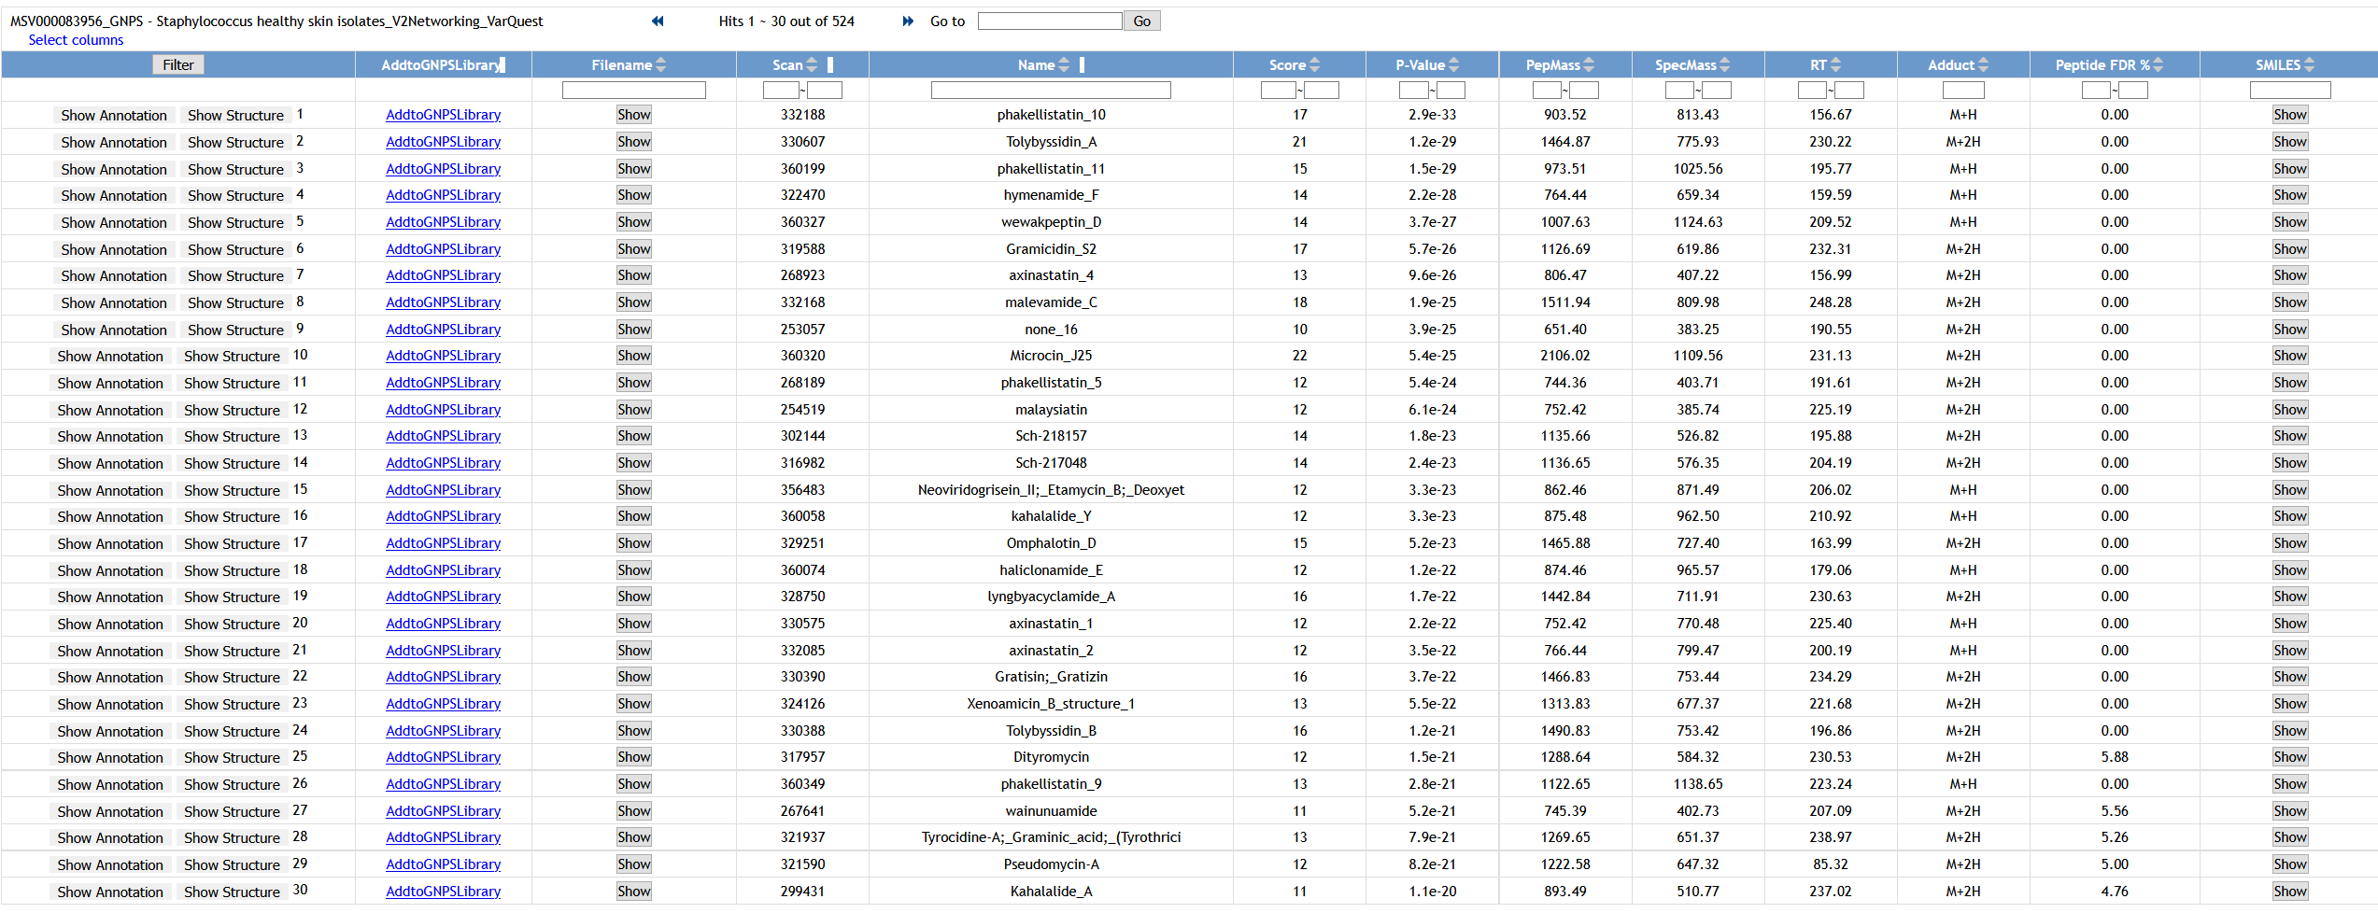
VarQuest GNPS - Staphylococcus healthy skin isolates: https://gnps.ucsd.edu/ProteoSAFe/status.jsp?task=f5496cbc5ab2400a813984069b7f8970

Slide 57
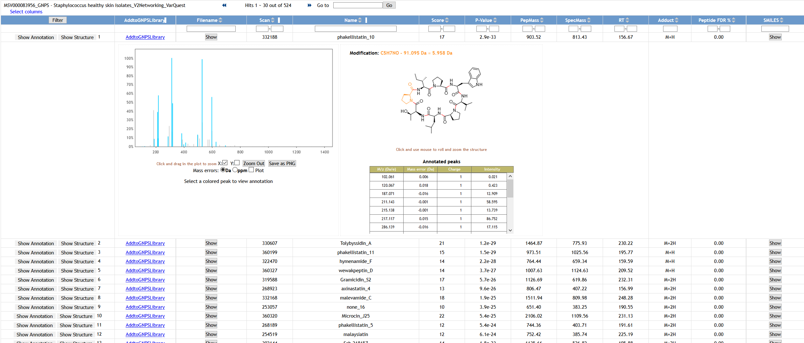
VarQuest GNPS - Staphylococcus healthy skin isolates: https://gnps.ucsd.edu/ProteoSAFe/status.jsp?task=f5496cbc5ab2400a813984069b7f8970

Slide 58
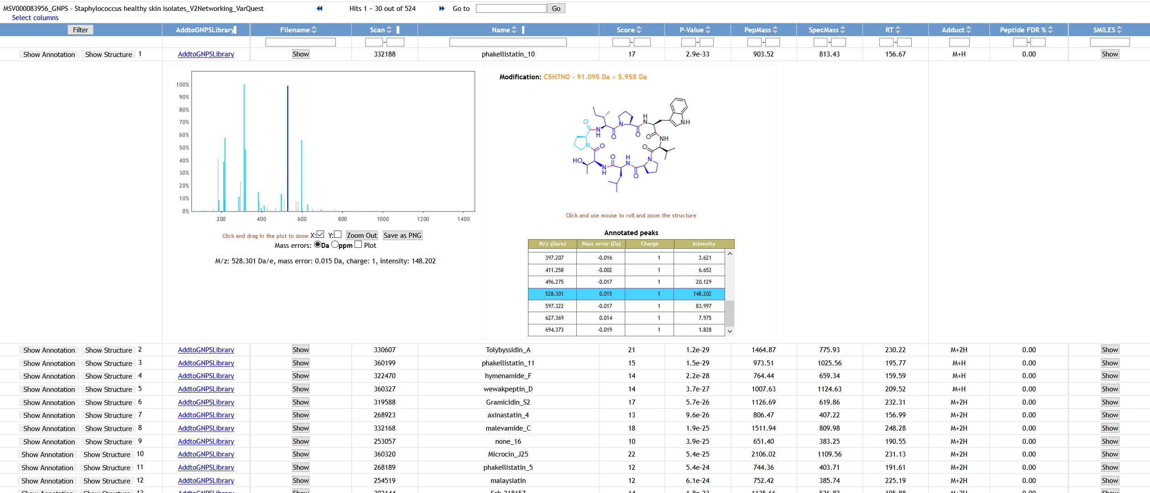
VarQuest GNPS - Staphylococcus healthy skin isolates: https://gnps.ucsd.edu/ProteoSAFe/status.jsp?task=f5496cbc5ab2400a813984069b7f8970
Candidate: phakellistatin_10

Slide 59
VarQuest GNPS - Staphylococcus healthy skin isolates: https://gnps.ucsd.edu/ProteoSAFe/status.jsp?task=f5496cbc5ab2400a813984069b7f8970
Phakellistatins: An Underwater Unsolved Puzzle
Mar Drugs. 2017 Mar; 15(3): 78.

Slide 60
Discussion
What peptide candidates did you find using the VarQuest workflow from the GNPS - Staphylococcus healthy skin isolates dataset?
MSV000083956
GNPS job link: https://gnps.ucsd.edu/ProteoSAFe/status.jsp?task=55aa34f4f0ff4c5ab1d47bf40017515b
Compare results with the classical molecular network for EXAMPLE 2
MSV000083956_GNPS - Staphylococcus healthy skin isolates_V2Networking
GNPS Job link: https://gnps.ucsd.edu/ProteoSAFe/status.jsp?task=22c9205c1d58433384df3cfbbf79eb52

Slide 61
Questions, Problems or Bugs?
Documentation: https://ccms-ucsd.github.io/GNPSDocumentation/
Forum: https://groups.google.com/forum/#!forum/molecular_networking_bug_reports
PRESENTER’S NAME
Presenter’s e-mail

